Slide 1
brainstorming on a roadmap for future developments of the KB services & metadata pipeline
EPSIT, 21/05/2024

Slide 2

brainstorming on a roadmap for future developments of the KB services & metadata pipeline
Inclusion of computational resources information in a/p resources metadata
Query Tool upgrade to query both a/p resrources and datasets metadata

Slide 3
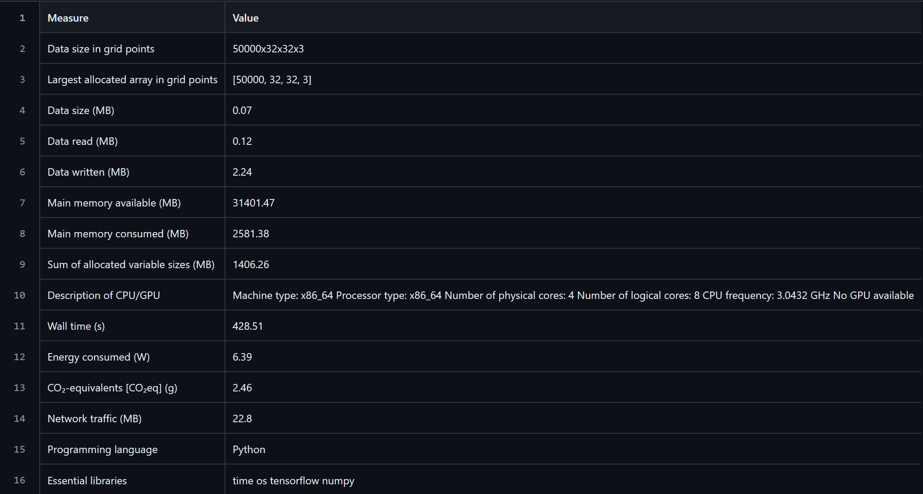
Inclusion of computational resources information in a/p resources metadata
A first version of a tool capable to collect, at the end of the execution of an a/p resource, information about the computational resources spent and the characteristics of the executing machine, has been developed and tested. The information is stored in a csv file, that can be uploaded during the a/p resource metadata editing/ingestion.
Currently, the csv file uploaded via the md-form, is stored in the KB-DB. The intention is to find a way to better exploit this information.
Idea is to visualise the information stored in the csv files, adding a column in the query tool results to display the presence of csv files.
CSV example

Slide 4
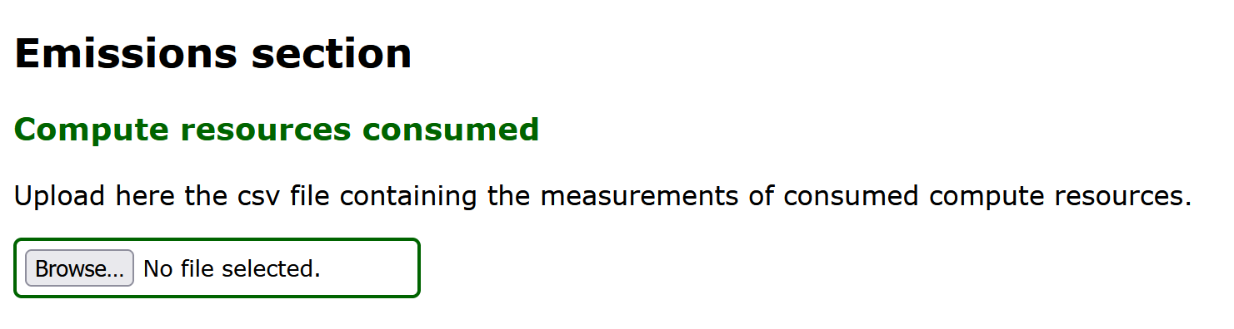
Inclusion of computational resources information in a/p resources metadata
Ingestion in the Knowledge Base DB, using the md-form, of the csv files containing information about the resources consumed

Slide 5
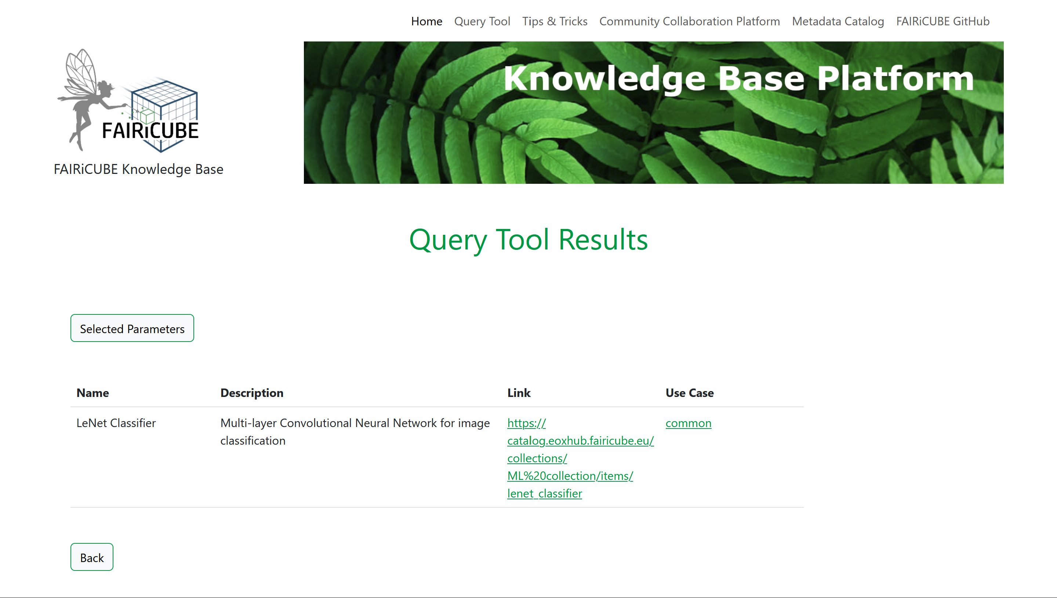

Inclusion of computational resources information in a/p resources metadata
Addition of a column in the query tool results to show the presence of csv files (and therefore the possibility to visualise the information on consumed resources)
New column

Slide 6
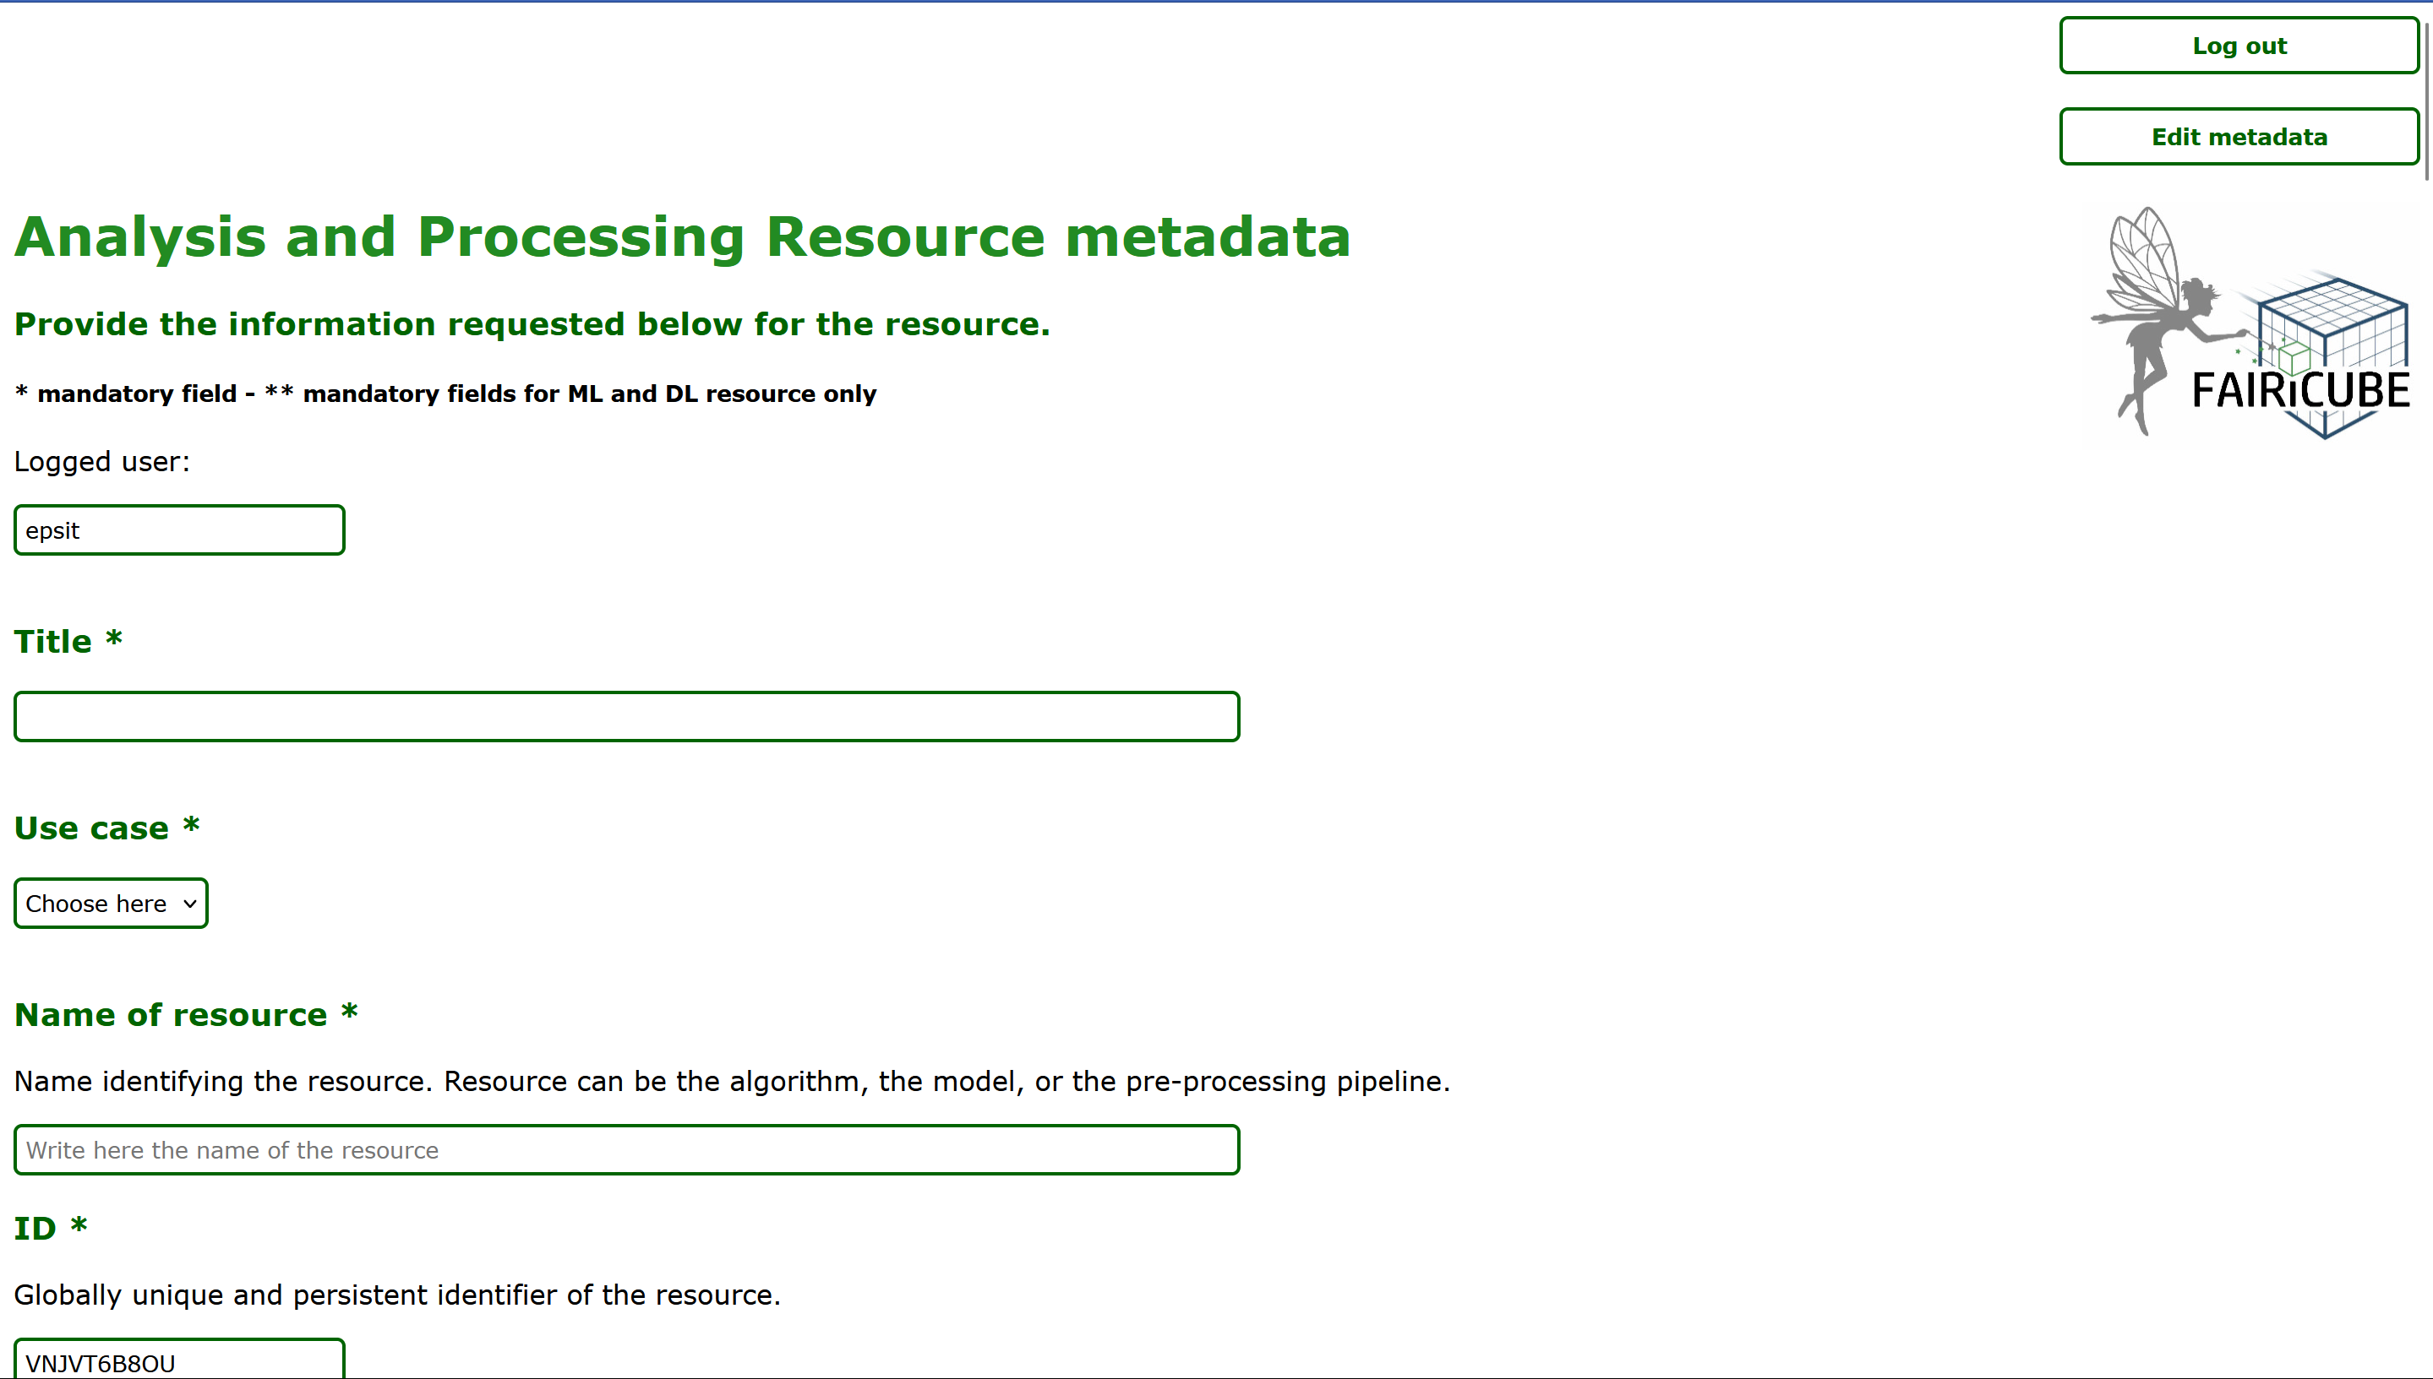
Inclusion of computational resources information in a/p resources metadata
Because several csv files can be generated for each a/p resource (depending on the execution configuration and also by users different from a/p resource metadata editors), idea is to allow upload of multiple csv files, creating a new section in the md-form.
CSV upload

Slide 7

CONSIDERATIONS
Do we agree that it is enough to offer only the visualisation of the computational resources and not even the possibility to query them (via predefined and/or customised queries)?

Slide 8
Query Tool upgrade to query both a/p resources and datasets metadata
WHY?
To allow retrieving information in reply to the following question:
“Which datasets for biodiversity UCs and which algorithms on those datasets have been used?”

Slide 9
Query Tool upgrade to query both a/p resources and datasets metadata
We have envisaged 2 alternative options:
Option a
Ingest in the KB database all datasets metadata present in the catalog (creating an ad-hoc routine to be launched periodically)
Up-grade the QT to enable the execution of “cross-table” queries, like the example above
Option b
Create a new tool capable to search simultaneously the catalog and the current QT to perform a “combined query”

Slide 10




OPTION A
Complex query
Dataset metadata ingestion
Upgraded KB Query Tool
Data catalog
KB-DB

Slide 11
OPTION B
Dataset query
a/p resources query
Data catalog
New tool
Current KB Query Tool
Complex query
KB

Slide 12
CONSIDERATIONS
Option a
shorter development time
need to create a procedure to ingest the datasets metadata in the KB-DB
Option b
longer and more complex to develop (and by whom?)

